Slide 1
Customer Support System: An email to the customer.
Savitha Shree M (19981)

Slide 2
TABLE OF CONTENTS
INTRODUCTION
DESIGN
INSTALLATION
IMPLEMENTATION
SAMPLE OUTPUT
CONCLUSION

Slide 3
INTRODUCTION
The project is to use ChatGPT Models to send email to customer based on the comment provided for the products in an electronic company.
Email will be sent to customer based on text completion techniques appropriately based on the language preferred.

Slide 4
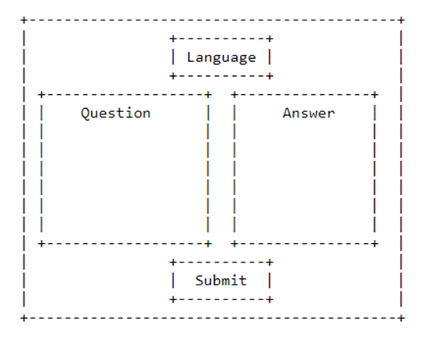
DESIGN
STRUCTURE OF THE WEB INTERFACE:

Slide 5
INSTALLATION
Create python virtual environment
sudo apt install python3.10 -venv
Install the required packages
python -m venv env
source env/bin/activate
pip install -r requirements.txt
Flask installation
pip install flask

Slide 6
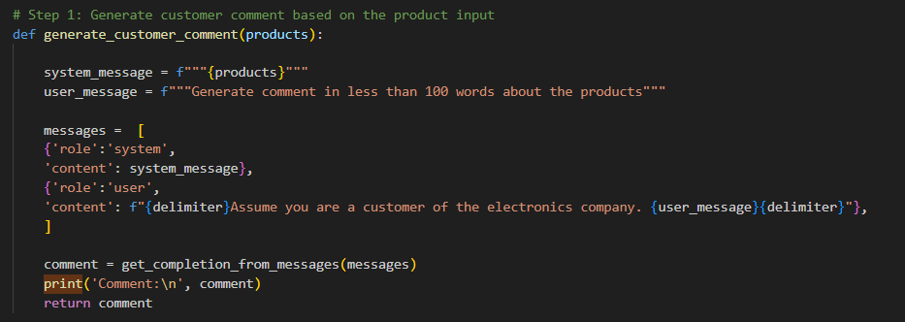
IMPLEMENTATION
STEP 1: GENERATE CUSTOMERS COMMENT

Slide 7
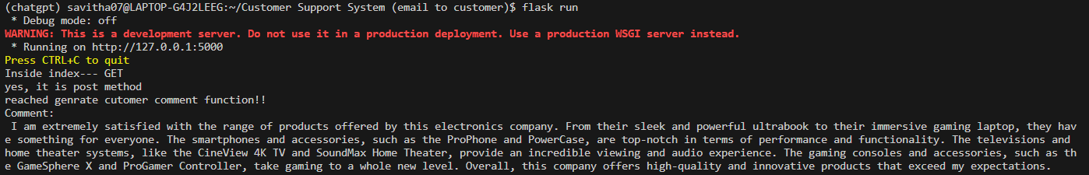
IMPLEMENTATION
When ChatGPT is given input with details of products and asked to generate comment assuming itself as a customer, it generates the output as below
OUTPUT:

Slide 8
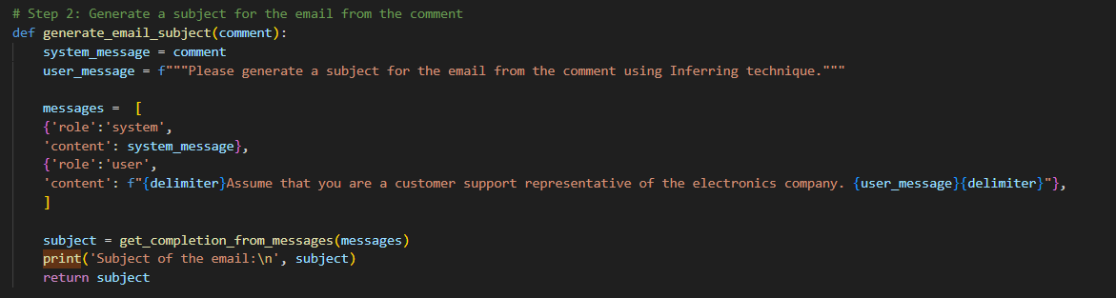
IMPLEMENTATION
STEP 2: GENERATE EMAIL SUBJECT

Slide 9
IMPLEMENTATION
When ChatGPT is given input with the created comment, asking to generate a subject for the email using Inferring technique.
OUTPUT:

Slide 10
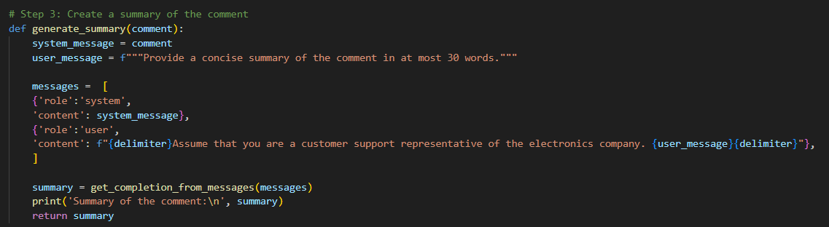
IMPLEMENTATION
STEP 3: GENERATE SUMMARY OF CUSTOMER COMMENTS

Slide 11
IMPLEMENTATION
When ChatGPT is given comments about the products and asked to generate a summary of the products in 30 words using Summarization, output looks like below.
OUTPUT:

Slide 12
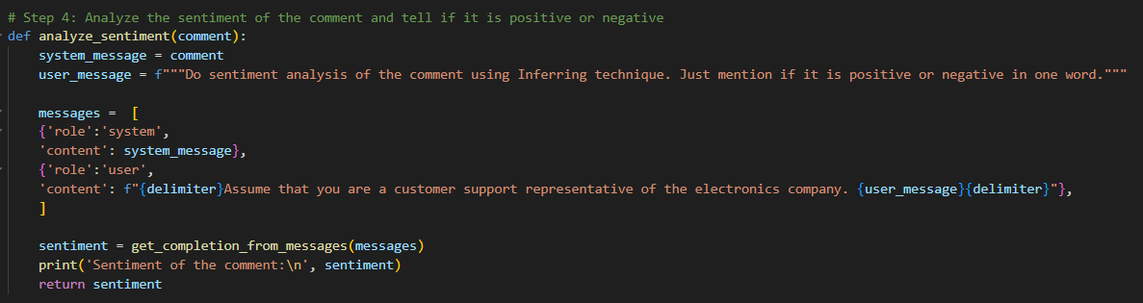
IMPLEMENTATION
STEP 4: SENTIMENT ANALYSIS OF CUSTOMER COMMENT

Slide 13

IMPLEMENTATION
On having the comments from customer, ChatGPT can analyse the sentiment of the comment and tell if it is positive or negative using Inferring technique.
OUTPUT:

Slide 14
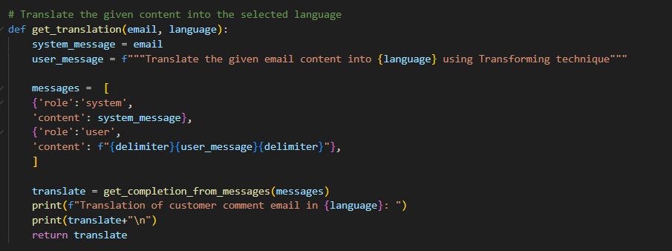
IMPLEMENTATION
The content generated must be transformed into the preferred language before sending it to the user. This can be done using one of the text completion techniques - Transformation.

Slide 15
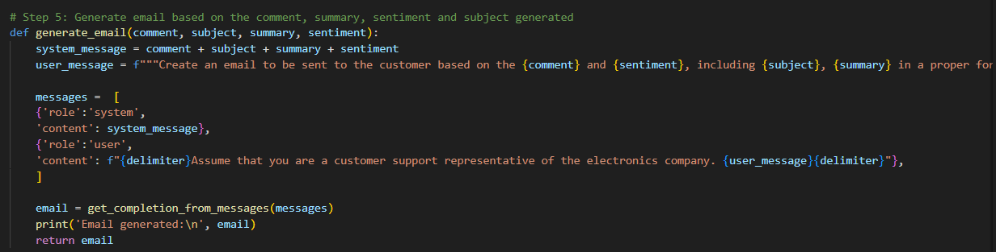
IMPLEMENTATION
STEP 5: GENERATE EMAIL

Slide 16
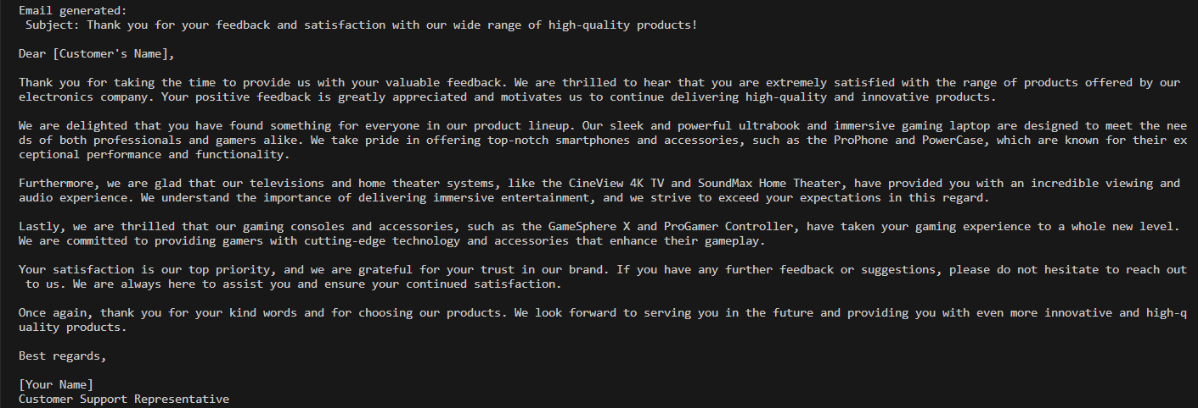
IMPLEMENTATION
Using the comment, summary, sentiment and subject, ChatGPT can generate an email based on the sentiment in the preferred language.
OUTPUT:

Slide 17
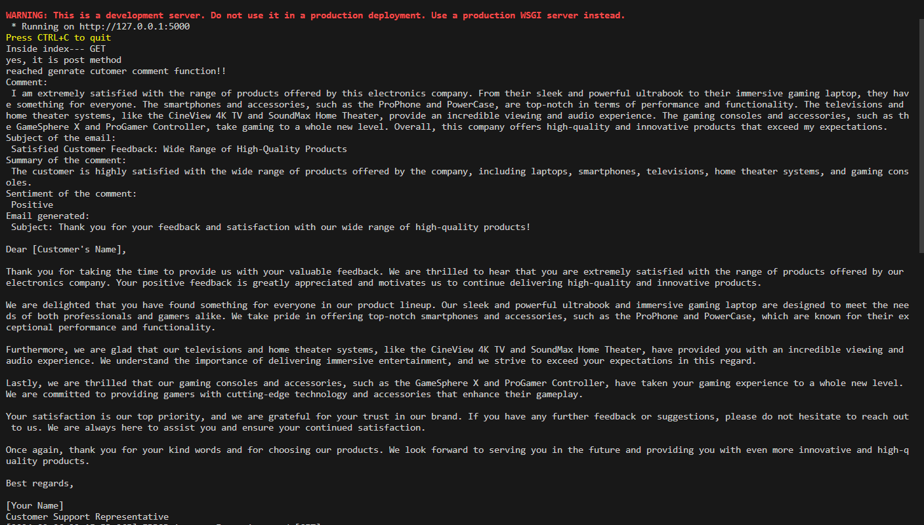
SAMPLE OUTPUT

Slide 18
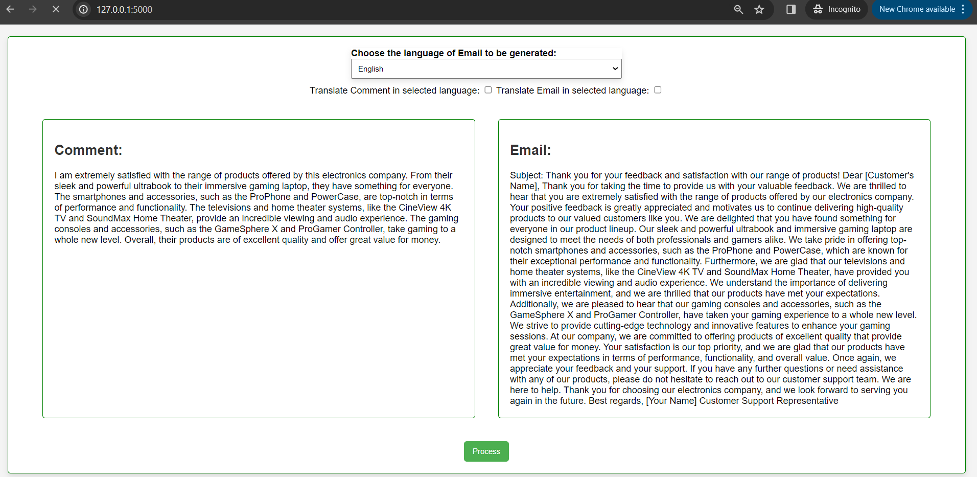
SAMPLE OUTPUT: English - English

Slide 19
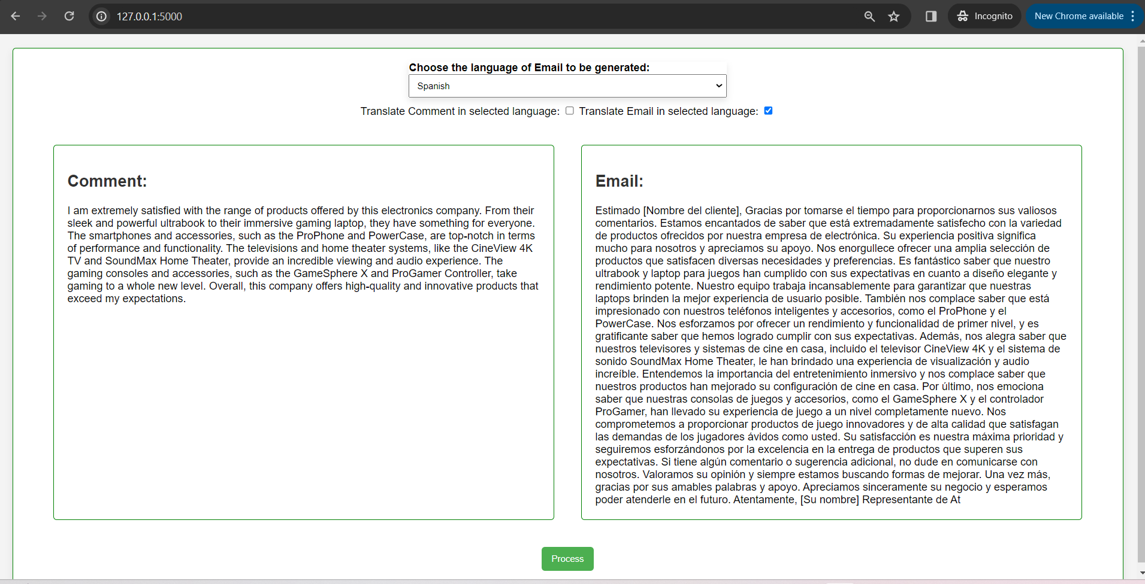
SAMPLE OUTPUT: English - Non-English

Slide 20
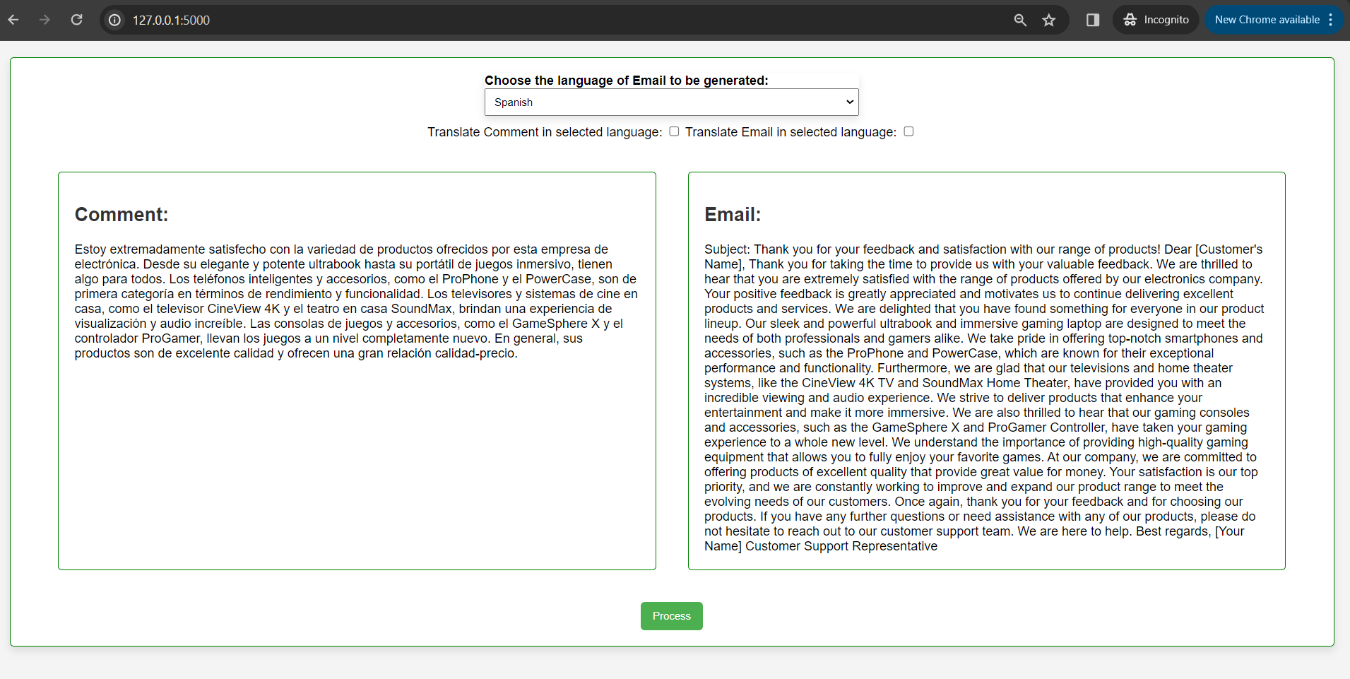
SAMPLE OUTPUT: Non-English - English

Slide 21
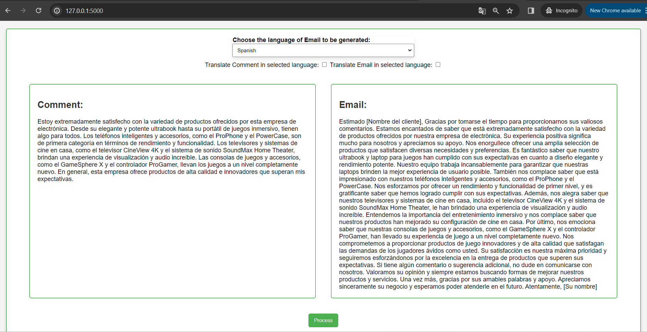
SAMPLE OUTPUT: Non-English - Non-English

Slide 22
CONCLUSION
GITHUB LINK: https://github.com/savithashreem07/Machine-Learning/tree/main/Customer%20Support%20System%20(email%20to%20customer)
REFERENCES: https://platform.openai.com/docs/guides/text-generation/chat-completions-api

